Slide 1
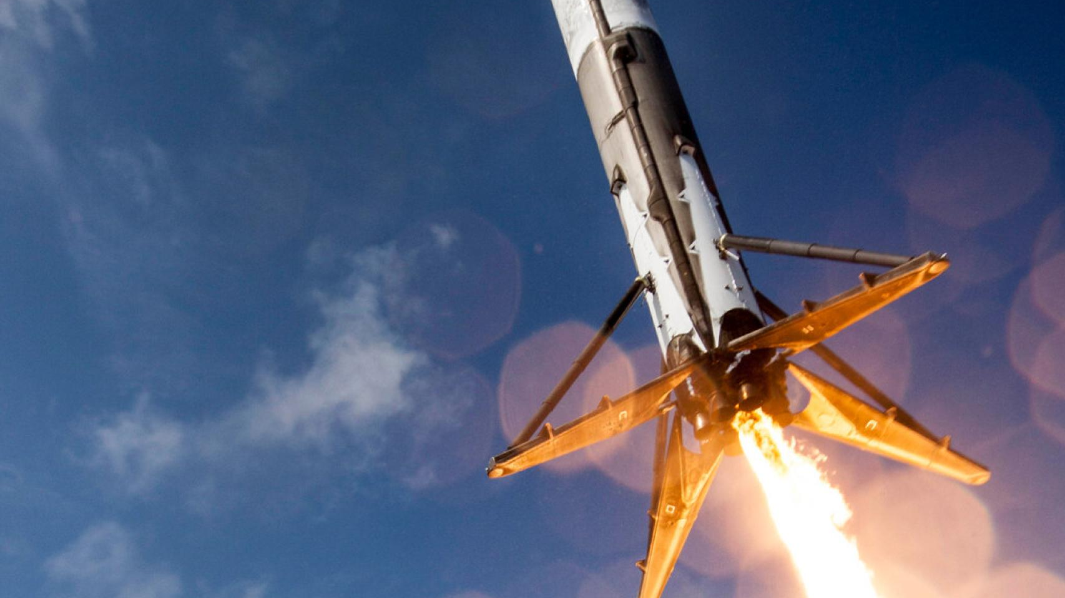
Data Science and Machine Learning Capstone Project
Predicting Falcon 9 First Stage Landing Success
Author: Sergio González Pellejero

Slide 2
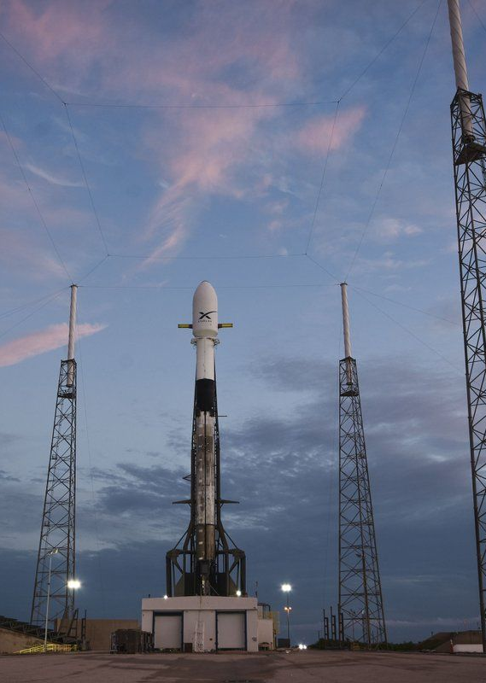

OUTLINE
EXECUTIVE SUMMARY
Key findings and insights
INTRODUCTION
Background and objectives
METHODOLOGY
Data collection, cleaning, and preparation
RESULTS
Data analysis and model evaluation
DISCUSSION
Interpretation of results and model performance
CONCLUSION
Key conclusions and insights gained
FUTURE DIRECTIONS
Next steps and improvements

Slide 3
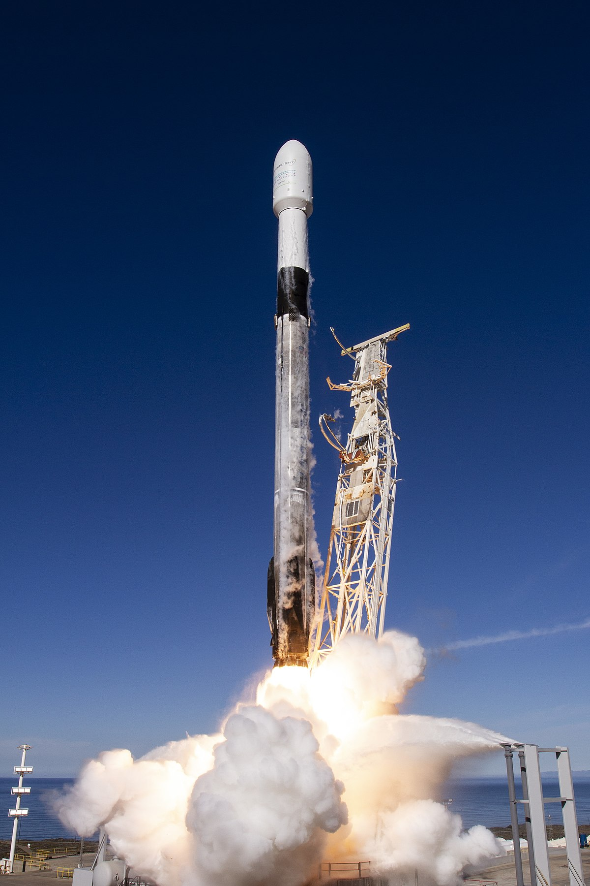
EXECUTIVE SUMMARY
This project explored SpaceX Falcon 9 missions to understand factors influencing first-stage landing success.
Through exploratory data analysis and supervised machine learning, key patterns and predictive insights were identified.
The most successful launch site was KSC LC-39A, and payloads in the 1900 - 5300 kg range obtained better landing success.
Several classification models were built, tuned, and evaluated — achieving accuracies of around 83%.
Findings can help SpaceX improve cost-efficiency and landing reliability in future missions.

Slide 4
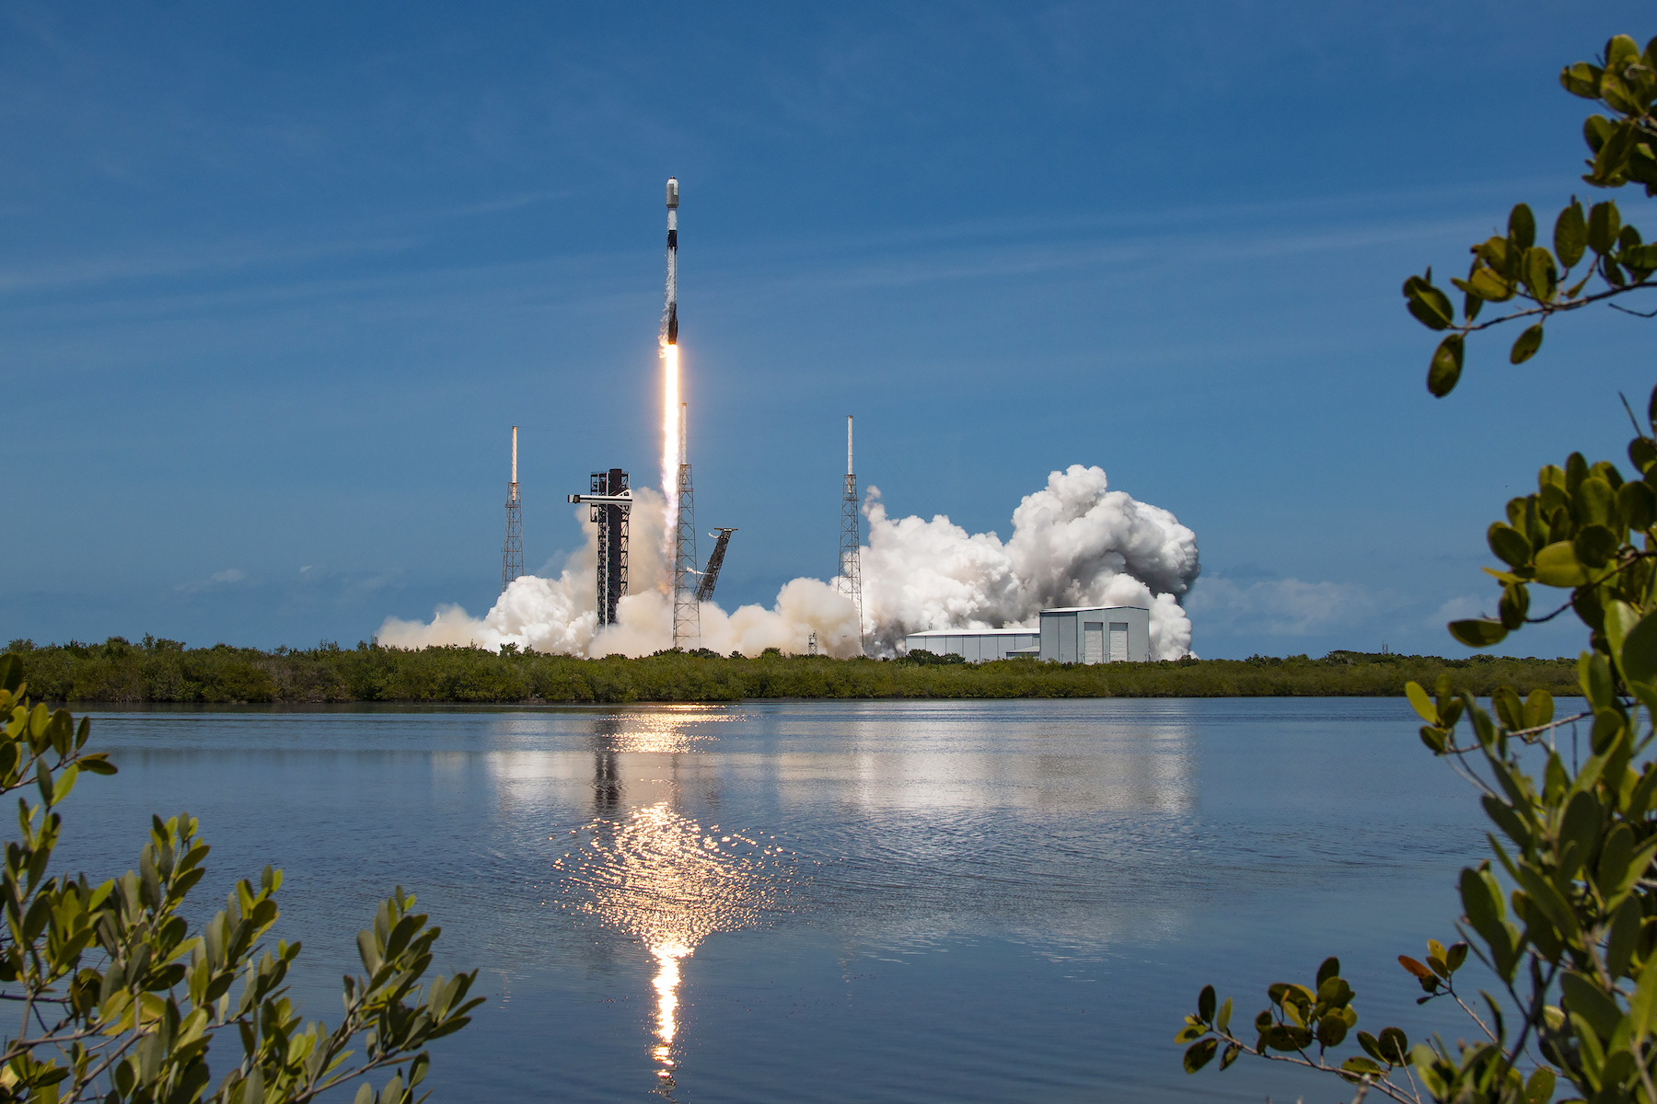
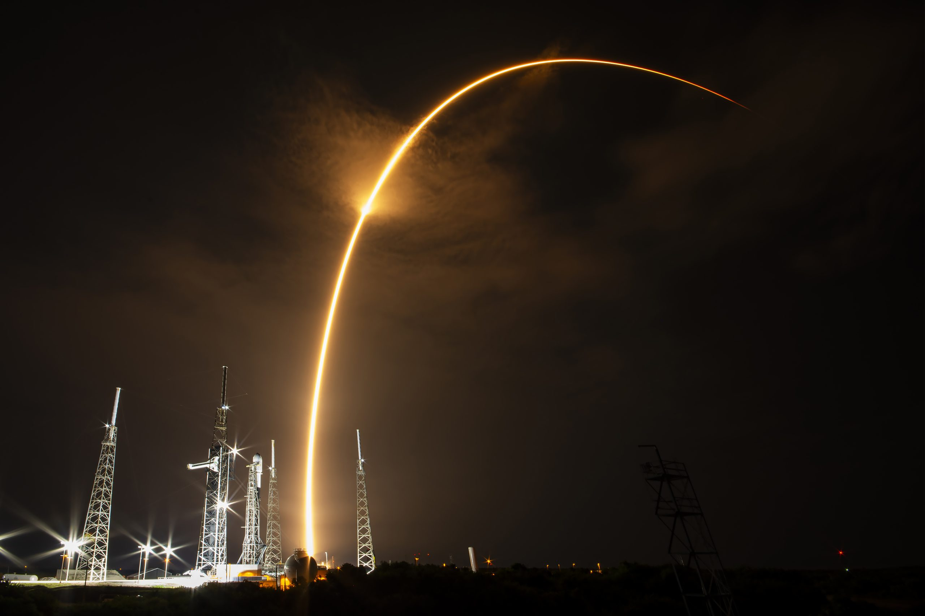
INTRODUCTION
SpaceX aims to reduce launch costs by reusing rocket stages; predicting first-stage landings is crucial.
This analysis combines historical mission data with machine learning to understand landing patterns.
The main objective is to identify key factors and develop models that accurately predict the success of Falcon 9 first-stage landings.

Slide 5
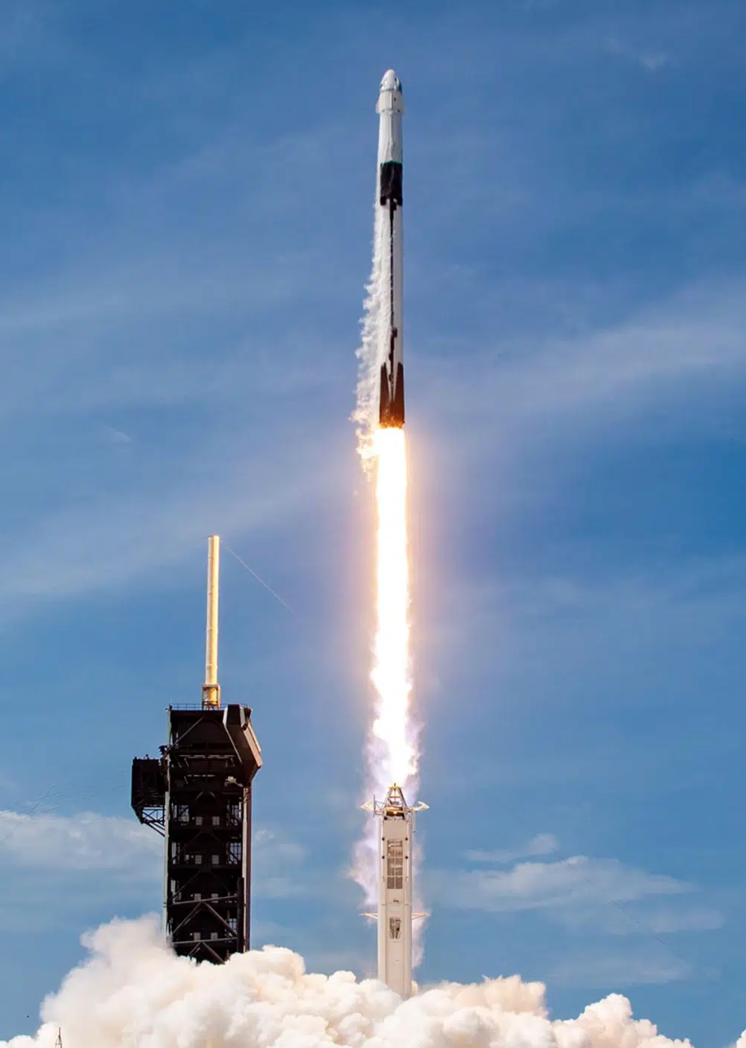
METHODOLOGY
Data Collection
Retrieve mission data from the SpaceX API and external sources using Python scripts.
Data Cleaning
Standardize formats, remove disparities, and handle missing values.
Label Engineering
Create target variable indicating first-stage landing success.
Data Wrangling
Explore and transform data to identify key features for model training

Slide 6
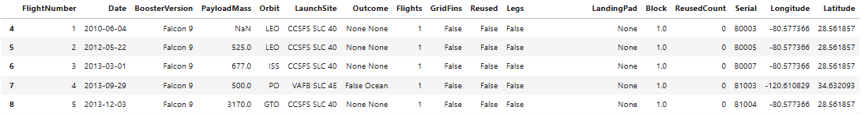
Data Collection: API Integration and Data Cleaning
Data Collection & Filtering
Data Cleaning
Raw dataset contains IDs for key features
Used API endpoints to enrich data with detailed info
Filtered dataset to include only Falcon 9 launches (excluded Falcon 1)
Filtered launches up to November 13, 2020
Reindexed Flight Numbers accordingly
Removed entries with multiple cores or payloads
Extracted single values from lists in cores and payloads columns
Converted date_utc to proper date format
Replaced missing values in PayloadMass with mean value

Slide 7
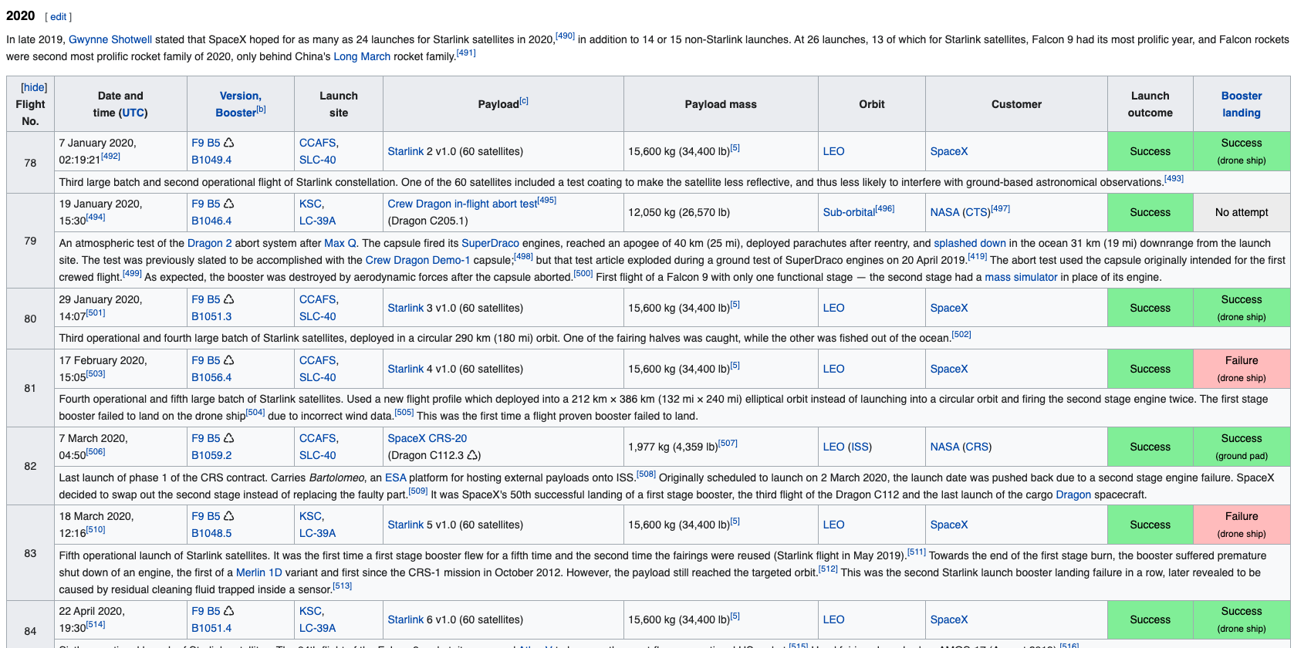
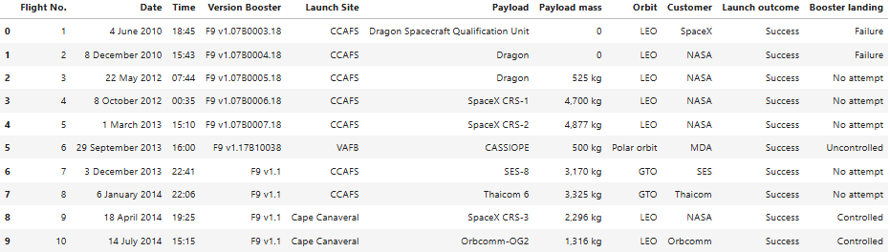
Data Collection: Web Scraping Techniques
Scraped Falcon 9 launch data from Wikipedia updated on 9th June 2021 using requests + Beautiful Soup
Extracted key info: flight number, date, booster version, launch site, payload, orbit, customer and landing status
Used custom parsing functions to clean and format data

Slide 8
Data Wrangling: Exploratory Analysis & Label Creation (Part 1)
Exploratory Analysis
Launches per launch site
Counted launches per orbit
Mission outcomes per type
CCAFS SLC 40 | 55
KSC LC 39A | 22
VAFB SLC 4E | 13
GTO | 27
ISS | 21
VLEO | 14
PO | 9
LEO | 7
SSO | 5
MEO | 3
ES-L1 | 1
HEO | 1
SO | 1
GEO | 1
True ASDS | 41
None | 19
True RTLS | 14
False ASDS | 6
True Ocean | 5
False Ocean | 2
None ASDS | 2
False RTLS | 1

Slide 9
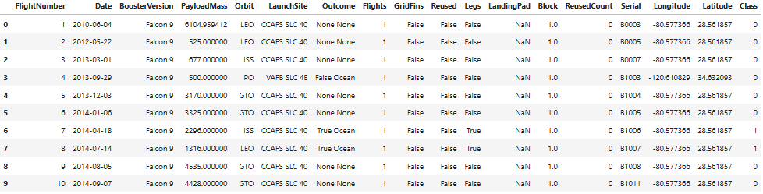
Data Wrangling: Exploratory Analysis & Label Creation (Part 2)
Outcome Labeling
Identified “bad outcomes”
Created binary label:
0 = unsuccessful landing
1 = successful landing
New column Class with landing success labels
Calculated mean success rate for dataset (66.67%)

Slide 10
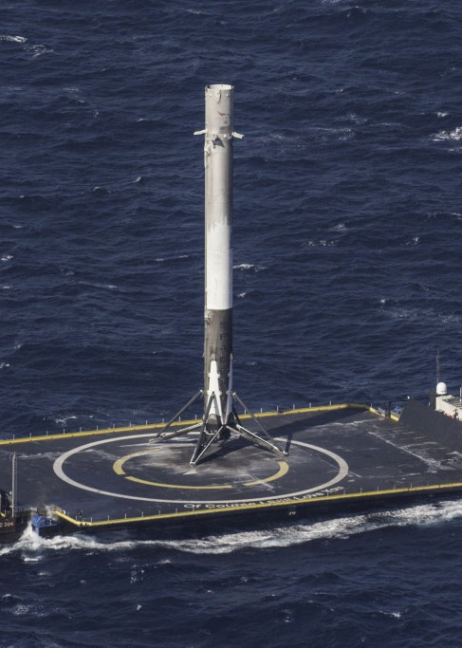
RESULTS
EDA
SQL and Python visualizations highlight trends by site, payload, and orbit.
Geospatial Analysis
Maps and clustering uncover spatial patterns in launch outcomes.
Interactive Dashboard
Enables dynamic analysis of success factors.
Landing Prediction
Four ML models trained to predict landing success from mission data.

Slide 11
Exploratory Data Analysis Using SQL: Launch Sites, Payloads & Outcomes
Launch Sites & Payload Analysis
Landing Outcomes
Unique launch sites: 4
Launches from KSC LC-39A : 5
Total payload by NASA (CRS): 45596 kg
Avg. payload (F9 v1.1): 2928 kg
Max payload: 15600 kg (12 F9 B5 versions)
Successful landings: 61
Failed/other landings: 40
First drone ship landing: 2016-04-08
Ground pad landings (4000–6000 kg): 3
Ranked landing outcomes:
No attempt | 21
Success (drone ship) | 14
Success (ground pad) | 9
Controlled (ocean) | 5
Failure (drone ship) | 5
Failure (parachute) | 2
Uncontrolled (ocean) | 2
Precluded (drone ship) | 1

Slide 12
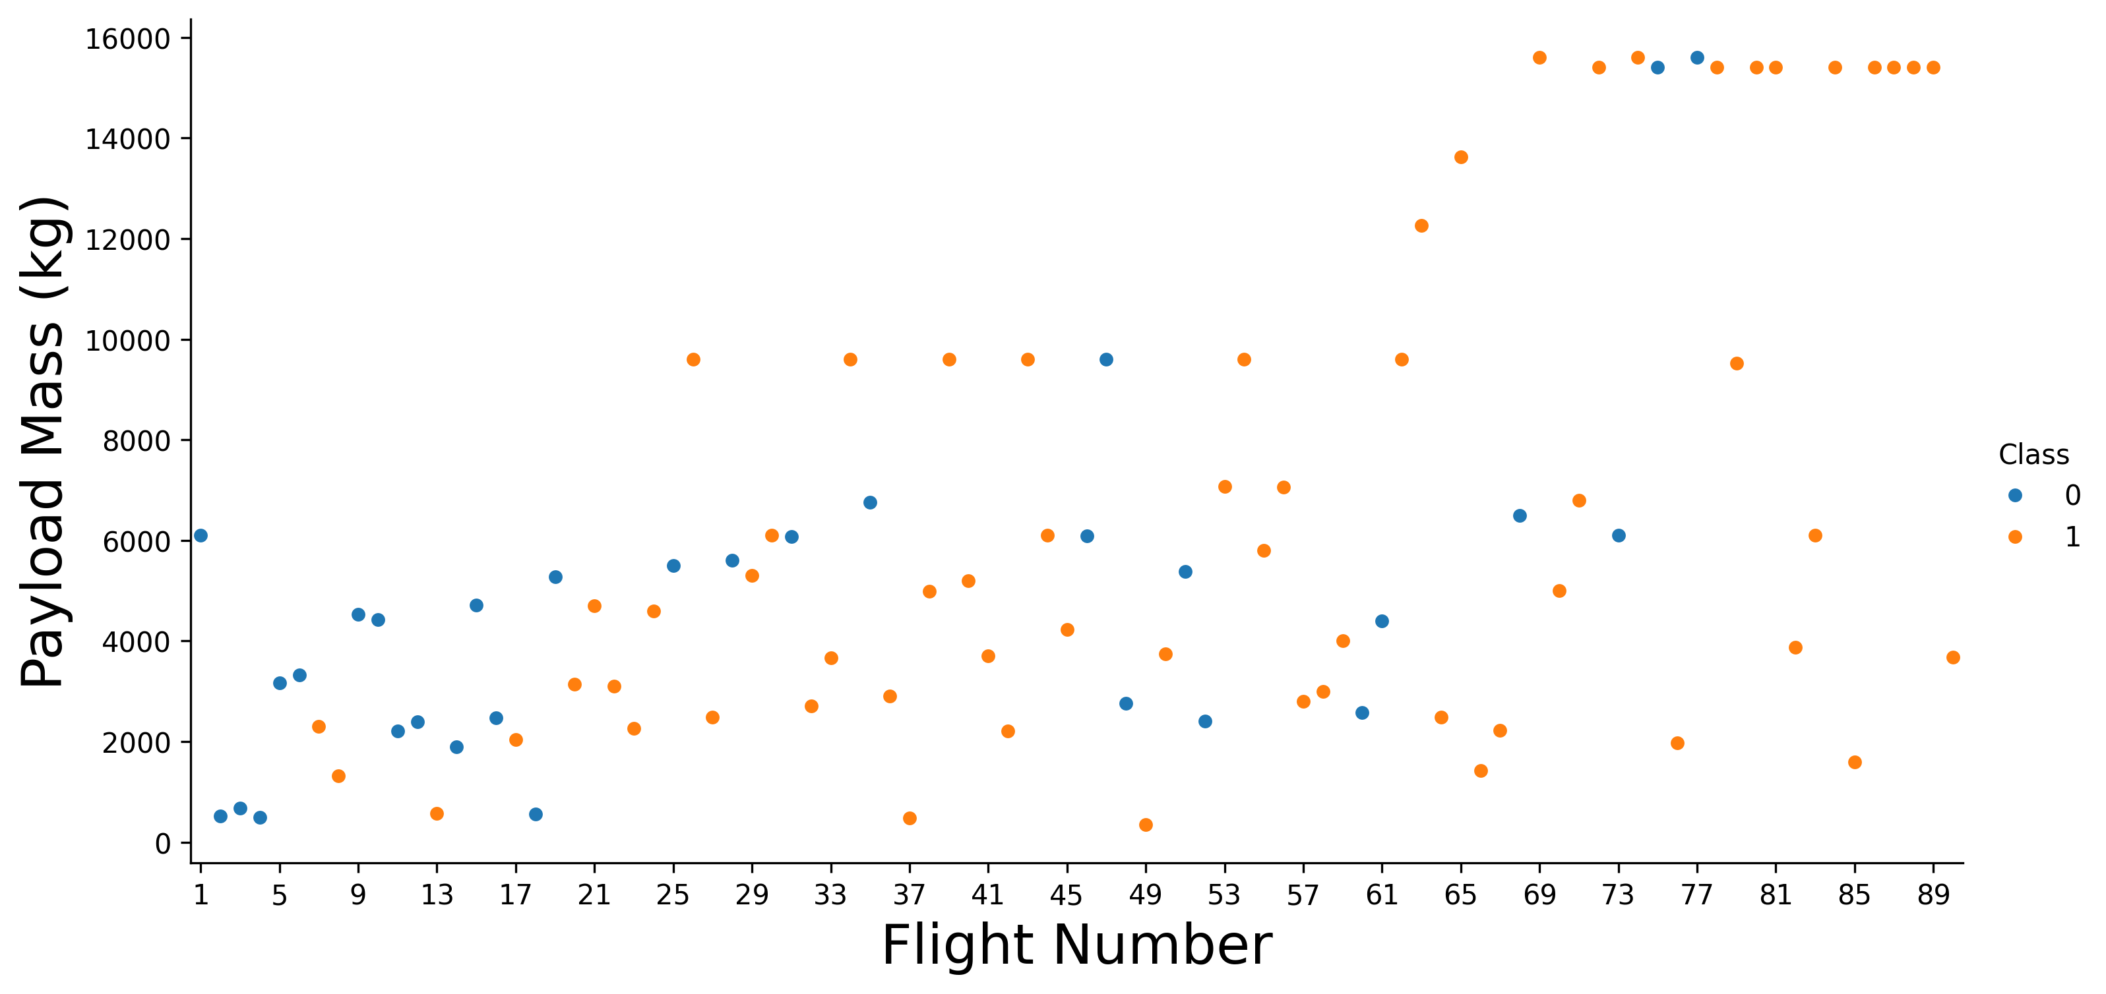
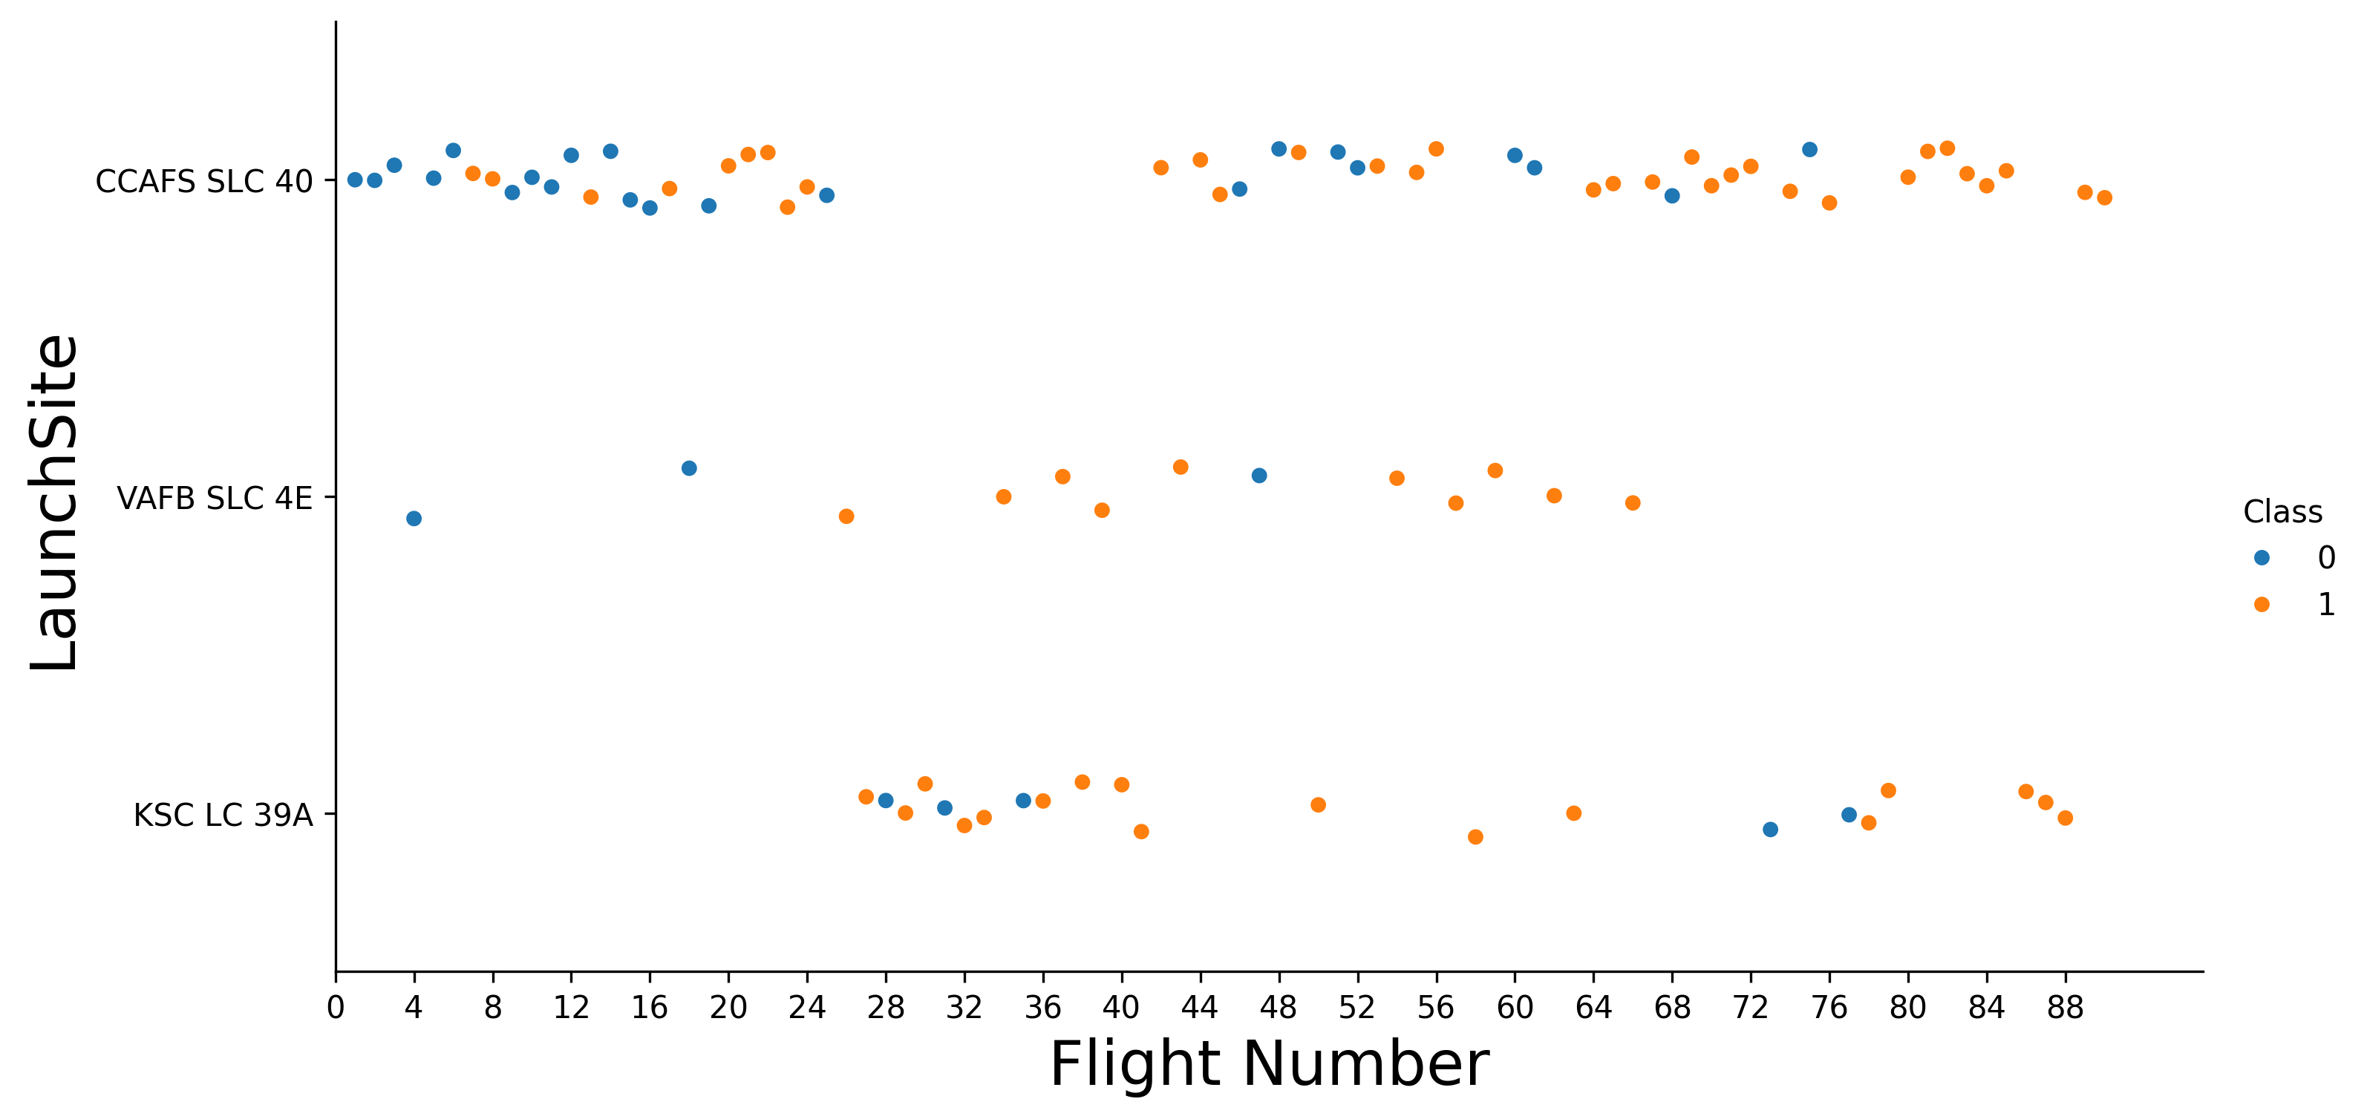
Exploratory Data Analysis: Launch Performance & Trends (Part 1)
Flight Number vs Payload Mass
Flight Number vs Launch Site
Success rate increases with flight number
First max payload (~15600 kg) at flight 69
High success rate for payloads ≥ 10000 kg
Success improves with flight number at all sites
CCAFS SLC-40 dominates <25 and > 42
Last VAFB SLC-4E launch at flight 66

Slide 13
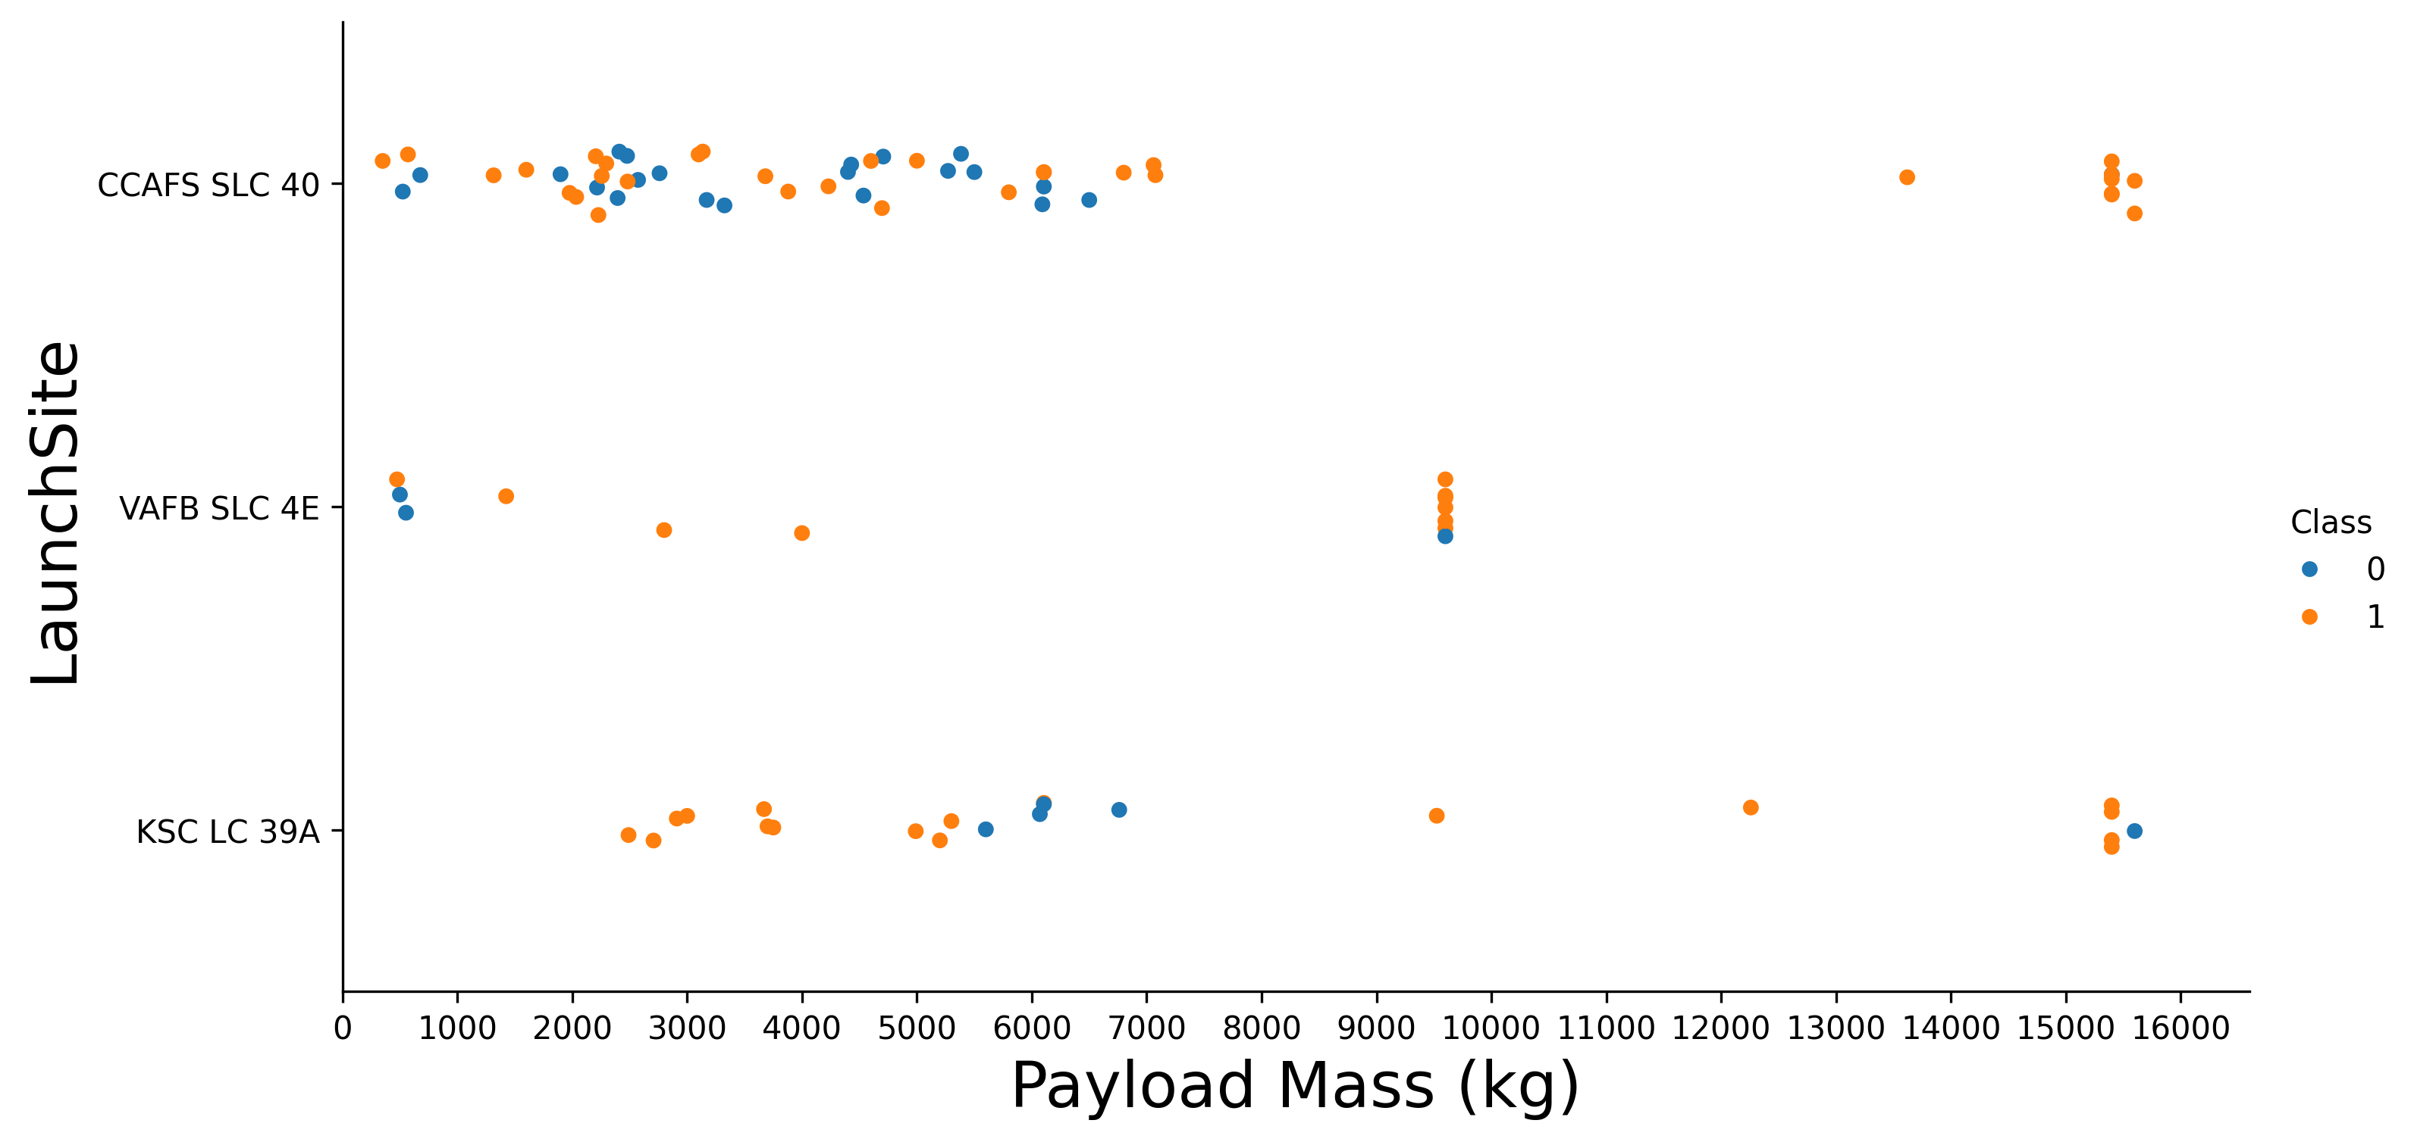
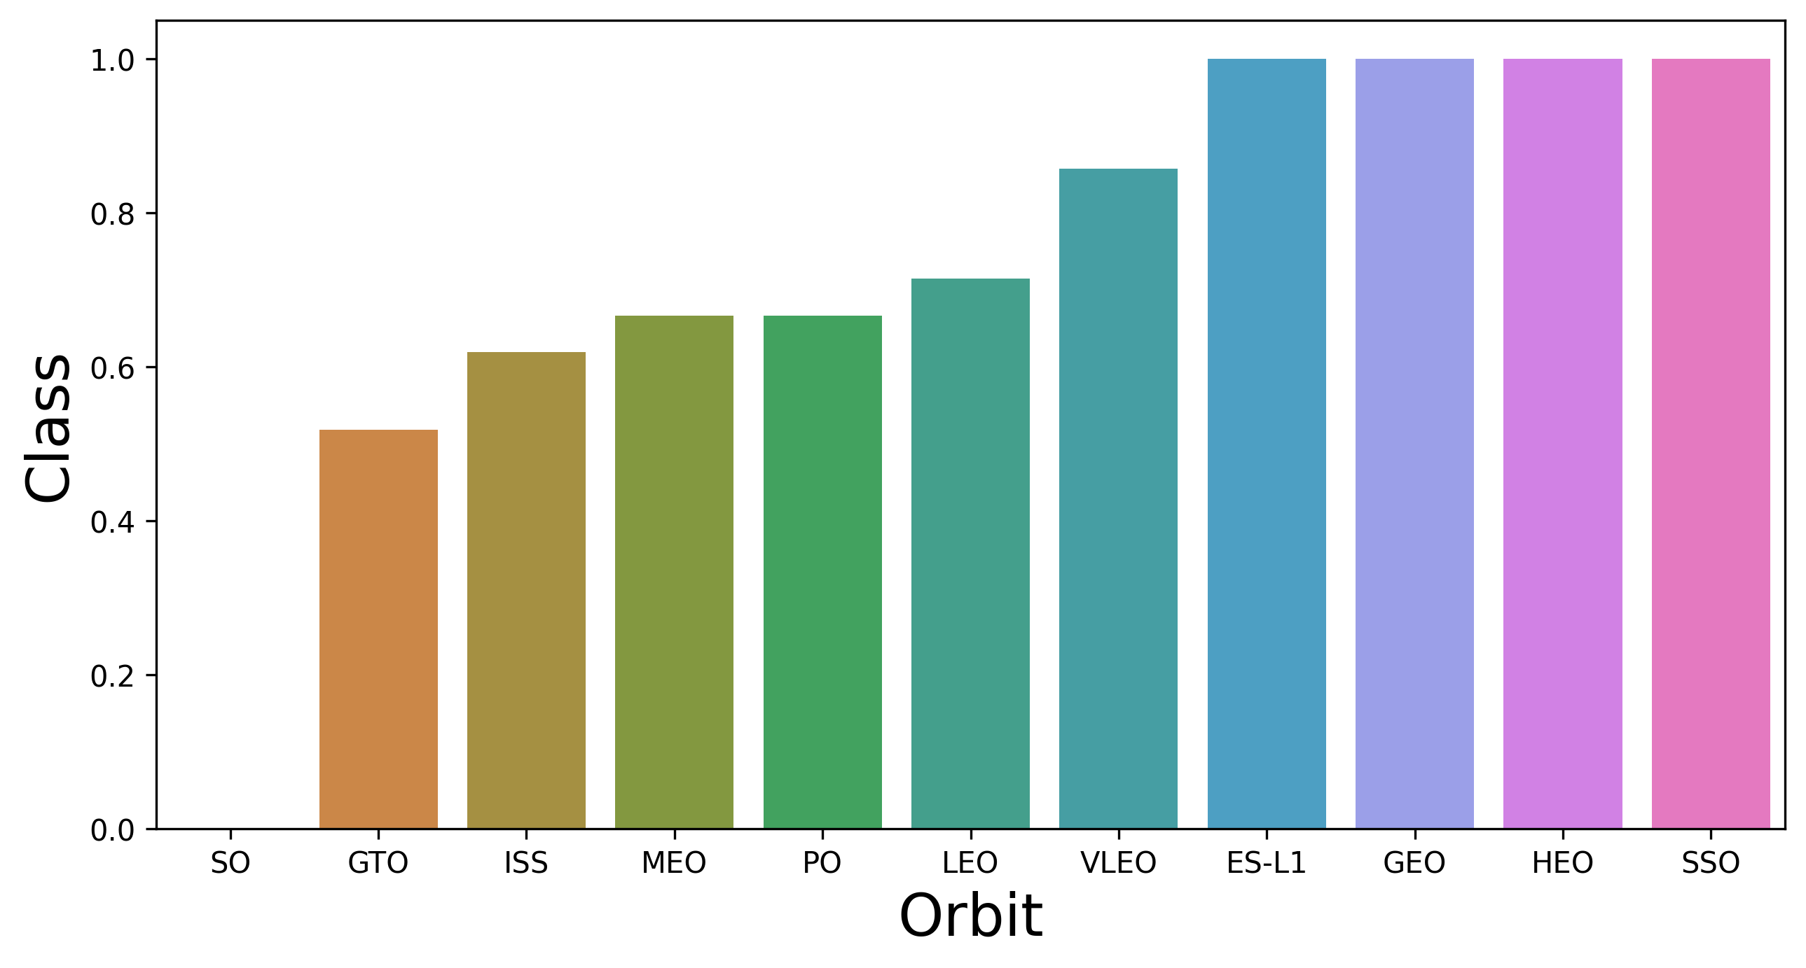
Exploratory Data Analysis: Launch Performance & Trends (Part 2)
Payload Mass vs Launch Site
Success Rate by Orbit
High success for payloads > 9000 kg
No >10000 kg launches at VAFB SLC 4E
Few launches in 8000–13000 kg range
SO orbit: 0%
GTO, ISS, MEO, PO, LEO, VLEO: 50–100%
ES-L1, GEO, HEO, SSO: 100%

Slide 14
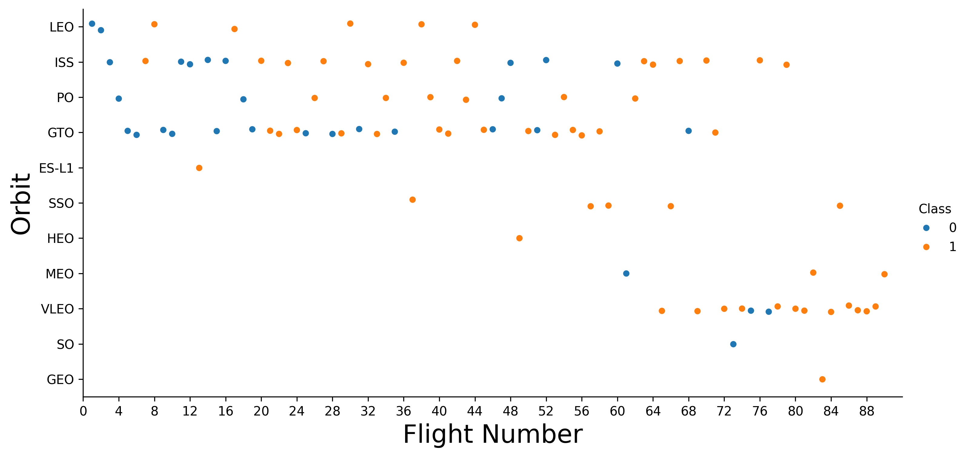
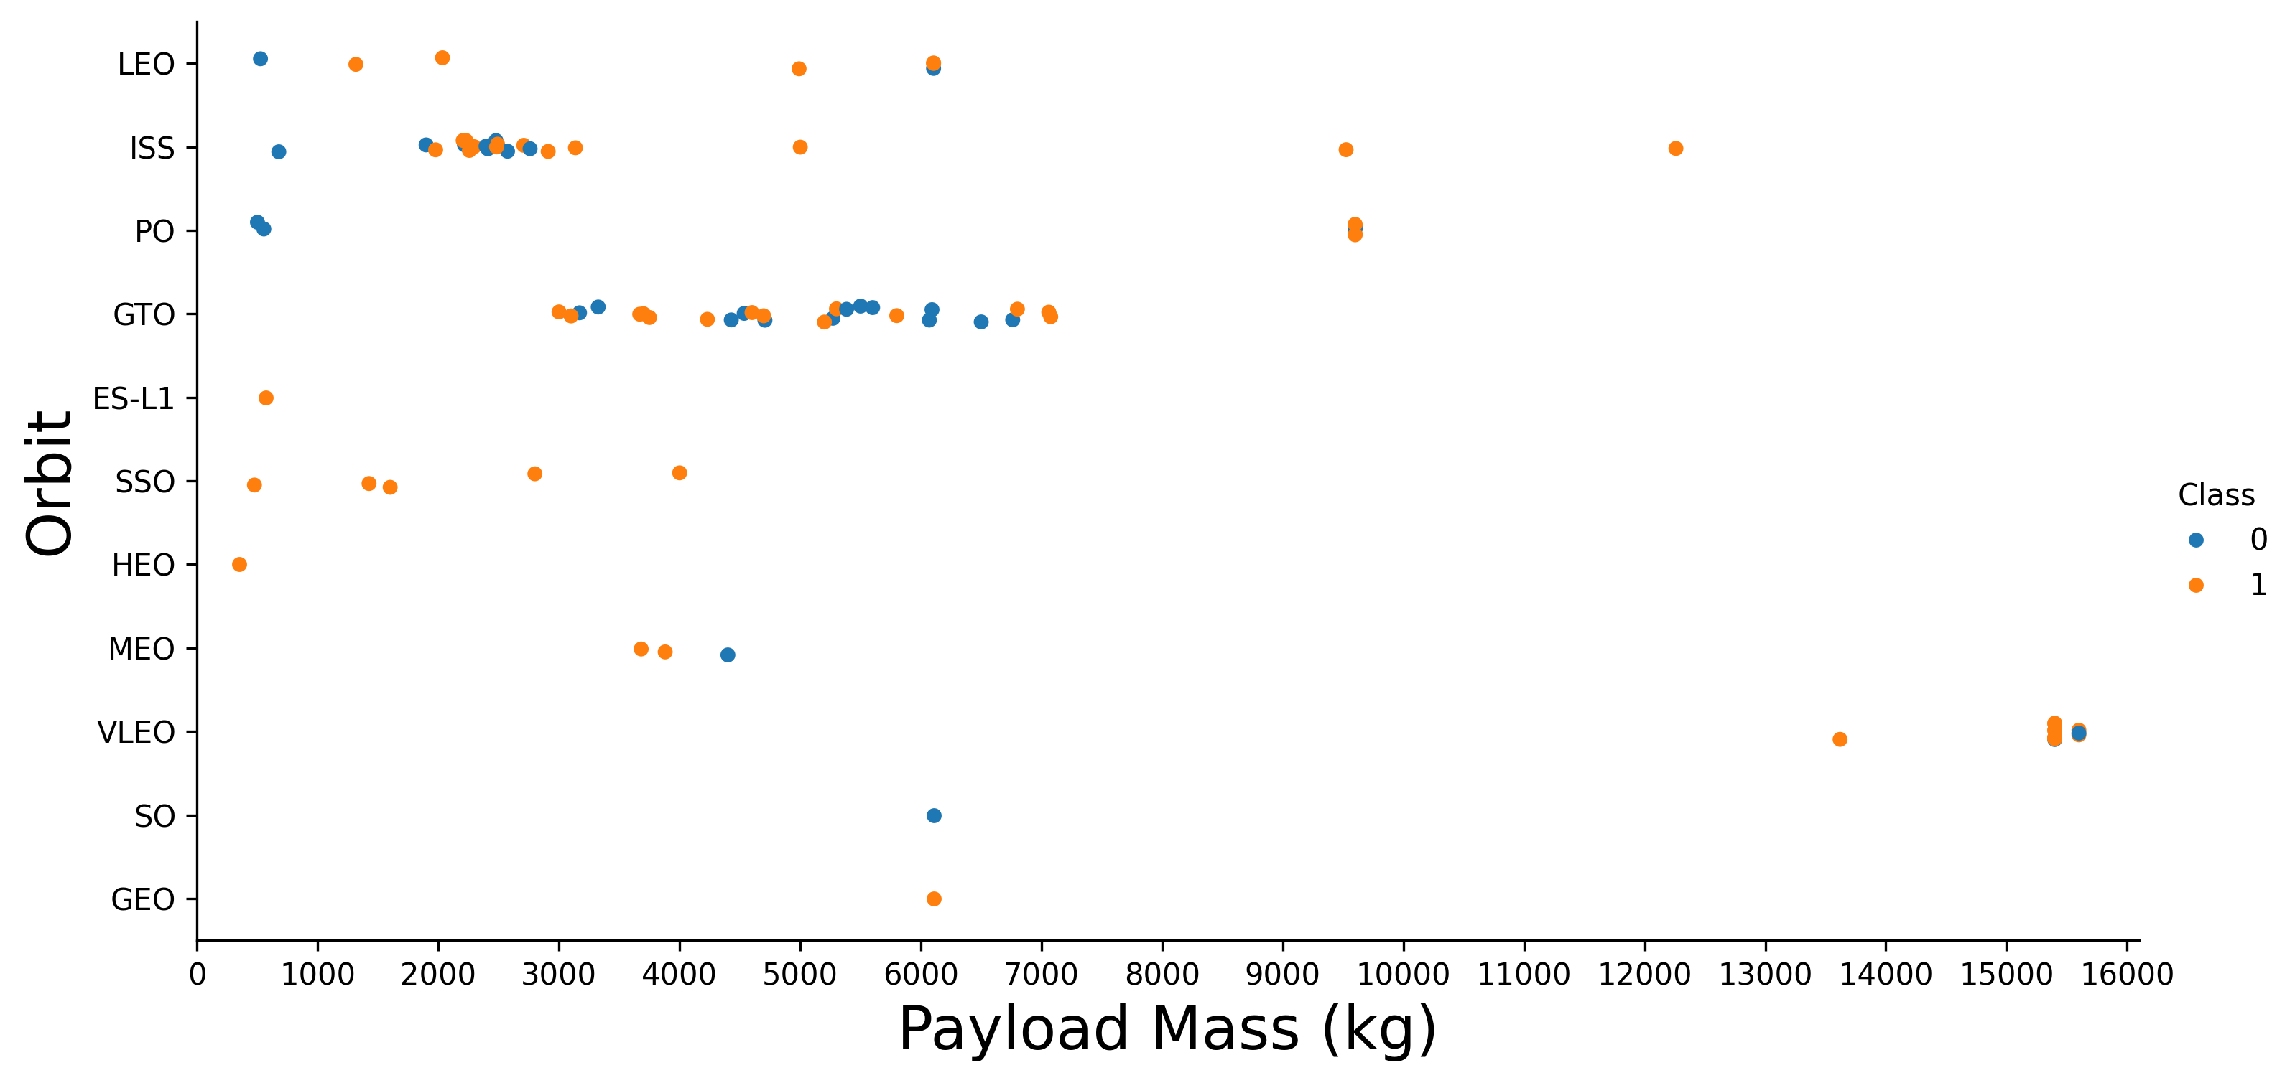
Exploratory Data Analysis: Launch Performance & Trends (Part 3)
Flight Number vs Orbit
Payload Mass vs Orbit
In LEO, success improves with flight number, not evident in GTO
Early launches mostly to LEO, ISS, PO, GTO; VLEO appears after flight ≈ 65
Higher success rate for heavy payloads in Polar, LEO, and ISS orbits
GTO shows both outcomes, with no clear success pattern

Slide 15
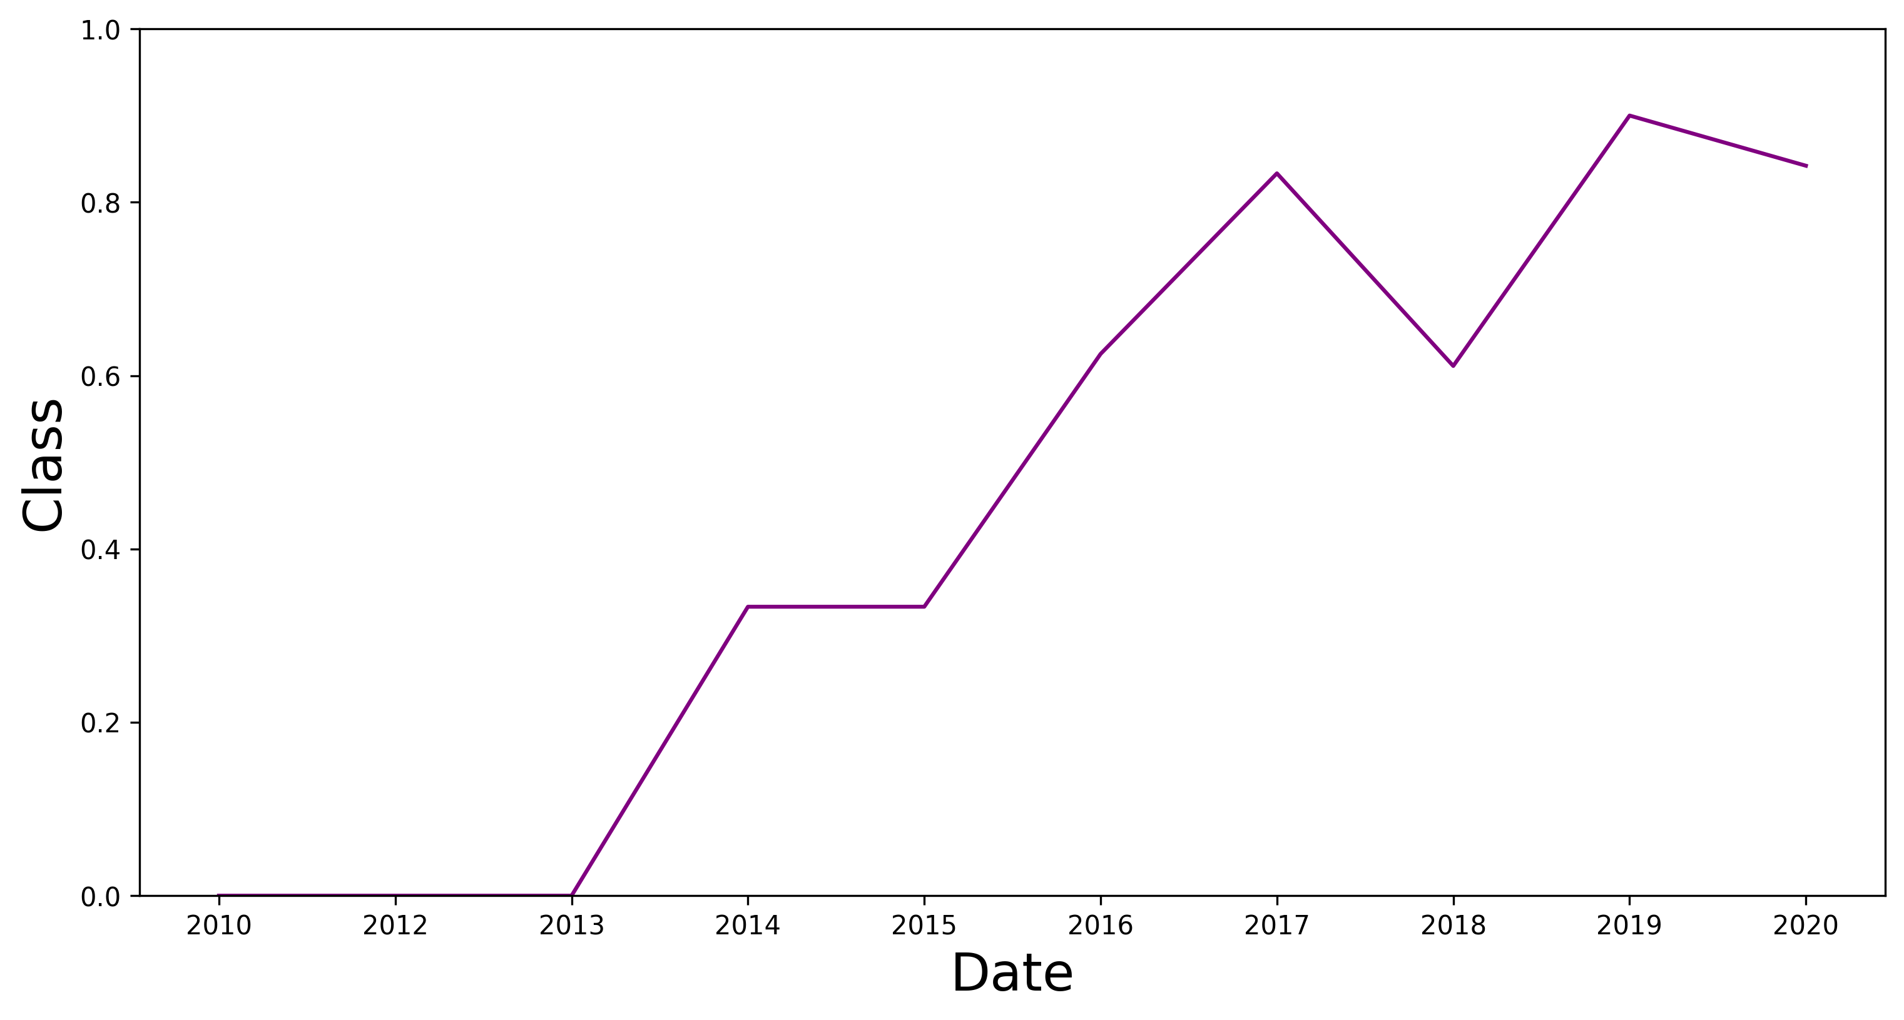
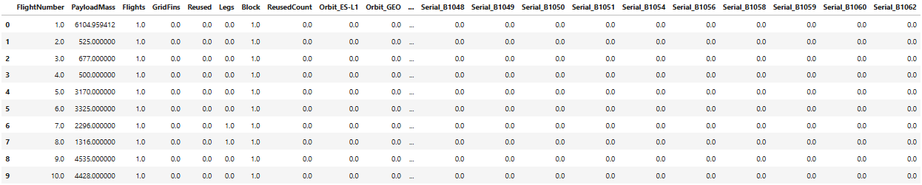
Exploratory Data Analysis: Launch Performance & Trends (Part 4)
Yearly Launch Success Trend
Feature Engineering
First launch occurred in 2010
First success recorded in 2014
Success rate steadily increased from 2013 to 2020.
Applied One-Hot Encoding to Orbit, LaunchSite, LandingPad, and Serial.
Final dataset: 90 rows × 80 columns, all as float64

Slide 16
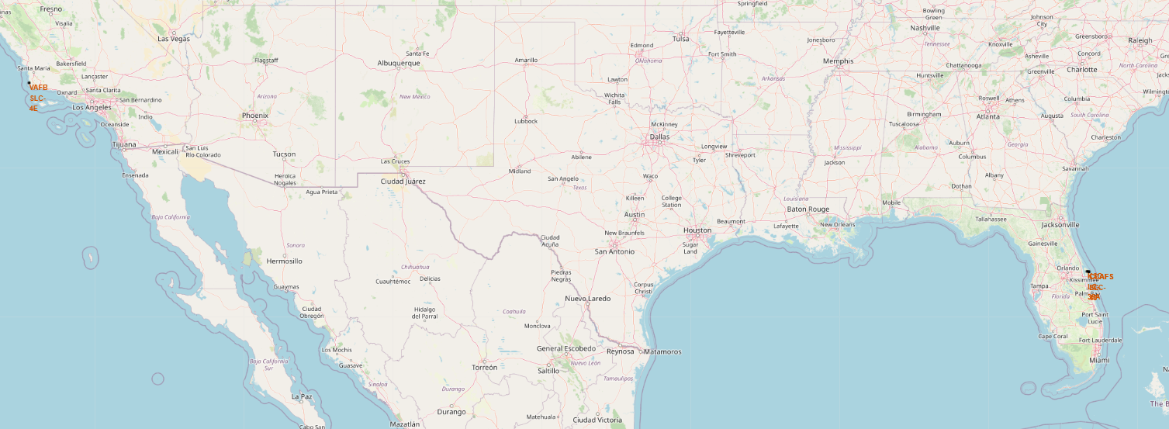
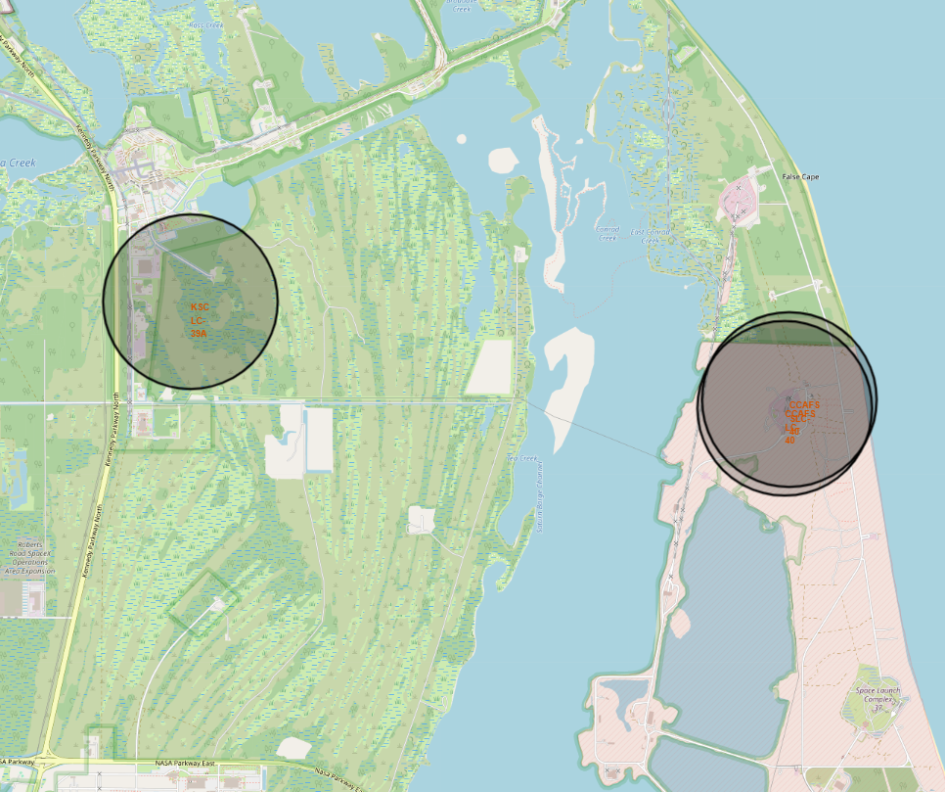
Geospatial Visualizations: Launch Sites (Part 1)
Launch Sites Geospatial Overview
Launch sites are near the Equator at a global scale (28.5°–34.6° N), giving a rotational speed boost for fuel efficiency.
Sites are close to the coast, allowing safer launches over the ocean
VAFB SLC-4E
KSC LC-39A
CCAFS SLC-40
CCAFS LC-40

Slide 17
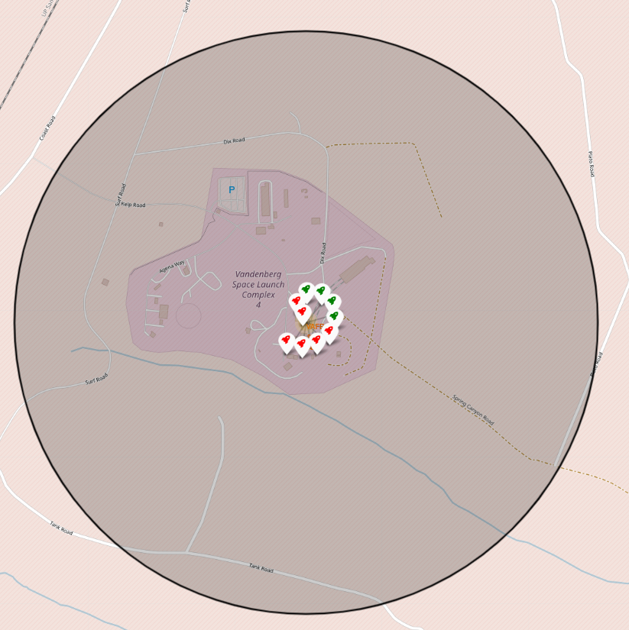
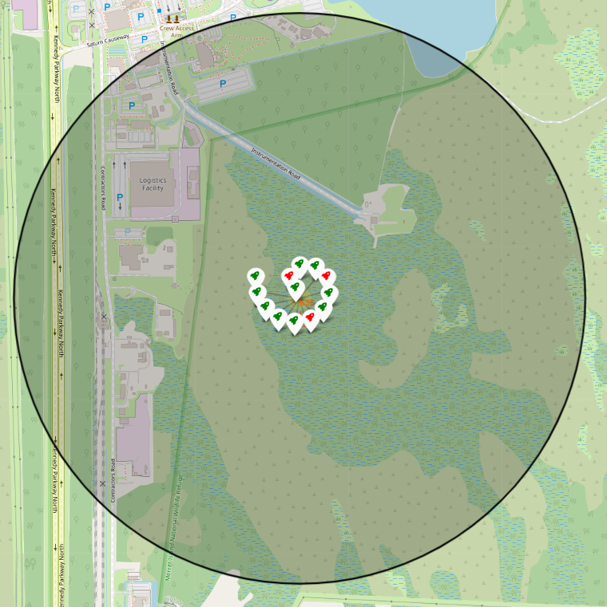
Geospatial Visualizations: Launch Sites (Part 2)
Launch Sites Success Rates
VAFB SLC-4E
KSC LC-39A
40%
77%

Slide 18
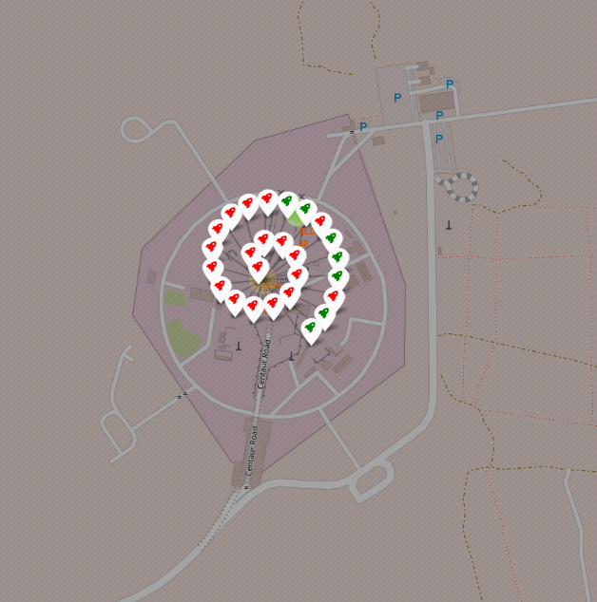
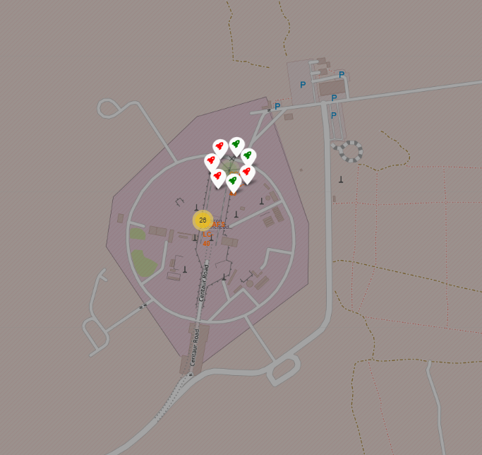
Geospatial Visualizations: Launch Sites (Part 3)
Launch Sites Success Rates
CCAFS LC-40
CCAFS SLC-40
27%
43%

Slide 19
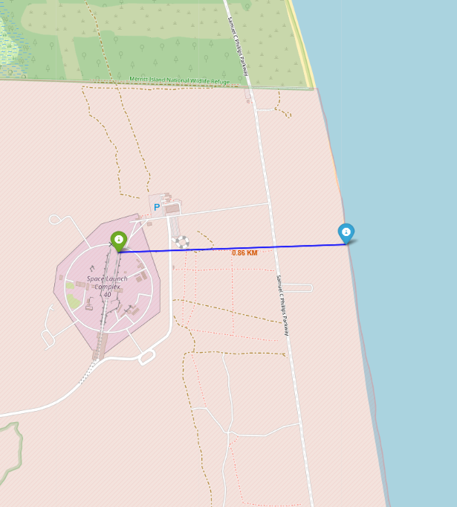
Geospatial Visualizations: Launch Sites (Part 4)
Proximity Analysis of Launch Sites
Usually close to highways for easy access
Near railways for transport and logistics of equipment
Located near the coastline to allow safe launches over water
Keep a safe distance from major cities to reduce risk

Slide 20
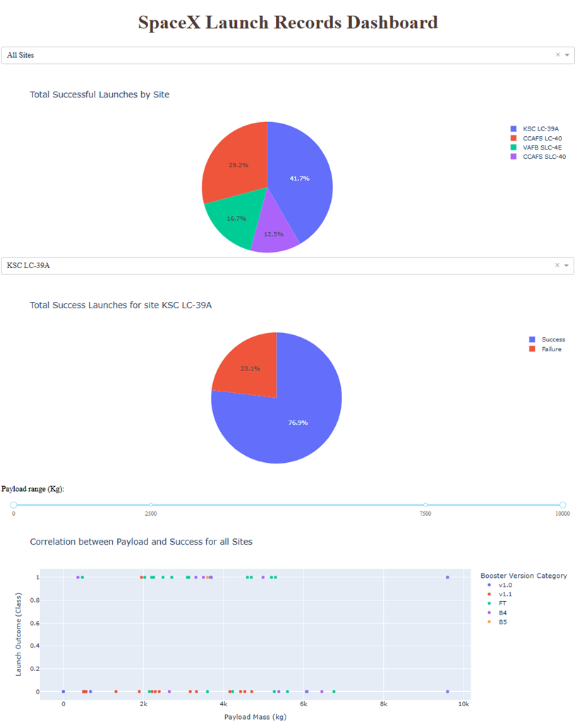
Interactive Dashboard: Exploring Launch Success Metrics
KSC LC-39A leads in successful launches with 10 (41.7%) and highest success rate (76.9%)
Payloads between 1900-5300 kg show best success rates
Success rates by launch site:
CCAFS LC-40: 27%, 0% under 2000 kg
VAFB SLC-4E: 40%, all successes at 475 and 9600 kg
CCAFS SLC-40: 42.9%, better under 4000 kg
KSC LC-39A: 76.9%, 100% under 5500 kg and 0% above
Falcon 9 Booster FT has highest success rate

Slide 21
Landing Success Prediction: Model Evaluation (Part 1)
Data Preparation & Baseline Setup
Target Selection: identify and extract the variable to predict
Feature Scaling: normalize features using standardization
Train-Test Split: divide data into training (80%) and test subsets (20%)
Load Dataset: import main datasets

Slide 22
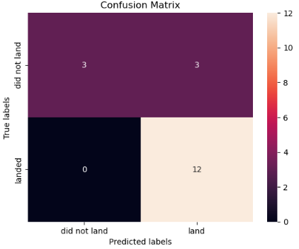
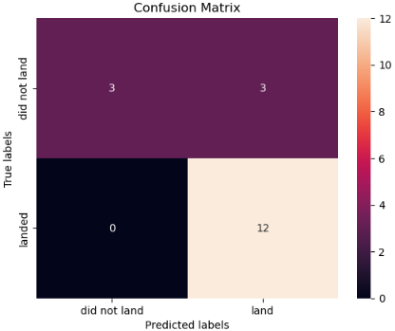
Landing Success Prediction: Model Evaluation (Part 2)
Logistic Regression
Best Params: C=0.01, penalty='l2', solver='lbfgs’
Cross-validation Accuracy: 84.6%
Test Accuracy: 83.3%
Support Vector Machine (SVM)
Best Params: C=1.0, gamma=0.0316, kernel='sigmoid’
Cross-validation Accuracy: 84.8%
Test Accuracy: 83.3%

Slide 23
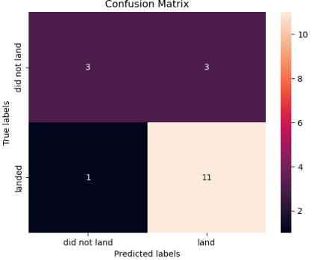
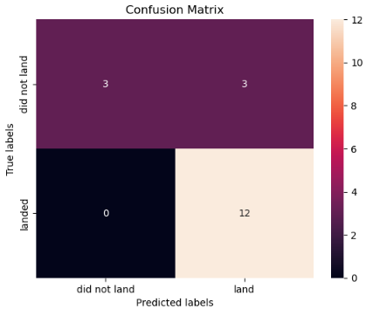
Landing Success Prediction: Model Evaluation (Part 3)
Decision Tree Classifier
Best Params: criterion = 'entropy', splitter = 'best’, max_depth = 10, max_features = 'sqrt’, min_samples_leaf = 4, min_samples_split = 2
Cross-validation Accuracy: 87,5%
Test Accuracy: 77,8% → ¡overfitting risk!
K-Nearest Neighbors (KNN)
Best Params: n_neighbors=10, algorithm='auto', p=1
Cross-validation Accuracy: 84,8%
Test Accuracy: 83,3%

Slide 24
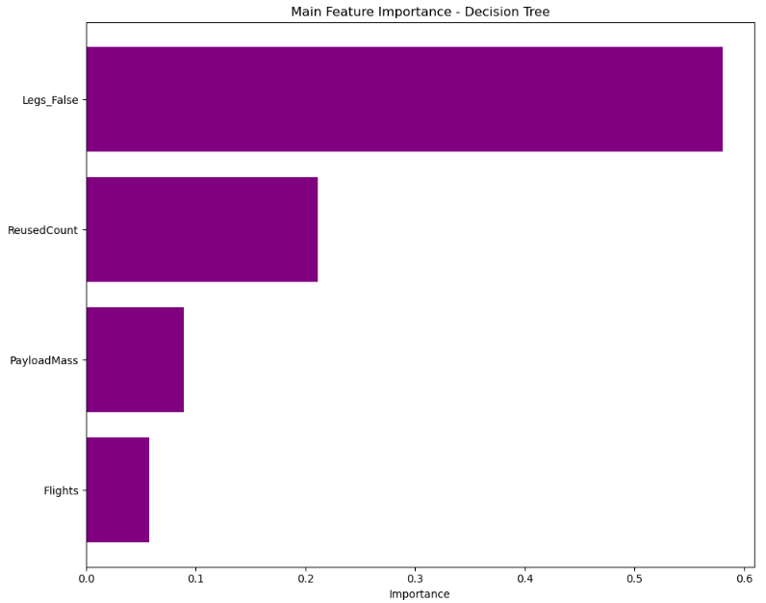
Landing Success Prediction: Model Evaluation (Part 4)
Decision Tree Classifier – Features Importance
Legs_False (58%): most important feature. Rockets without landing legs are much less likely to land successfully, highlighting the critical role of landing gear.
Reused Count (21%): higher reuse may reflect experience or wear. Reuse history significantly impacts landing outcomes.
Payload Mass (8.9%): heavier payloads can affect descent and control. Mass influences landing success.
Flights (5.7%): more flights may indicate experience or aging. Slight effect on landing.

Slide 25
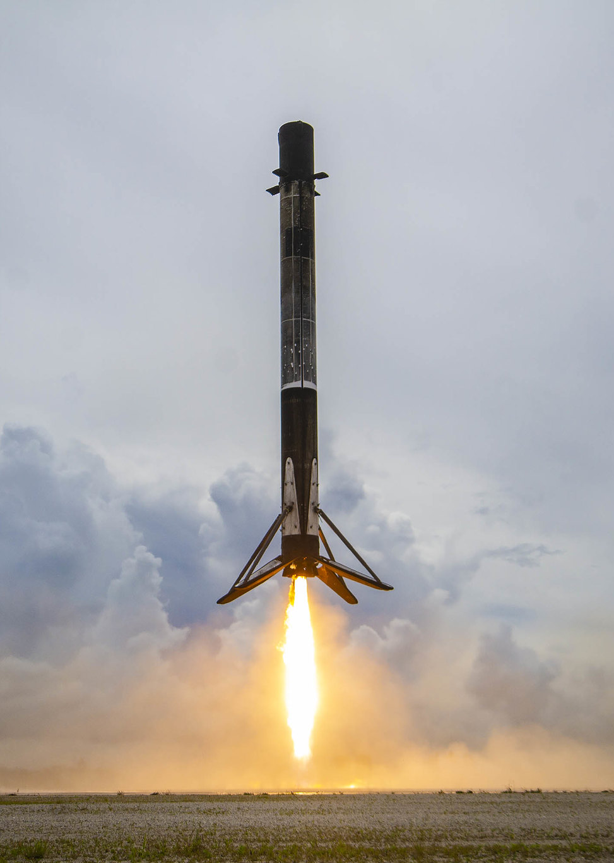
DISCUSSION
KSC LC-39A stands out with both the highest number of successful launches and the highest success rate (76.9%).
Payloads in the 1,900–5,300 kg range show the best landing success rates, which aligns with model insights.
All four models yield similar test accuracy (≈ 83%), except for Decision Tree, which performs lower (77.8%).
Despite tuning, all models produce 3 false positives on the test set.
The Decision Tree is the only model to generate false negatives (missed landings), suggesting less generalization.
Feature scaling and hyperparameter tuning proved essential for optimizing model performance.

Slide 26
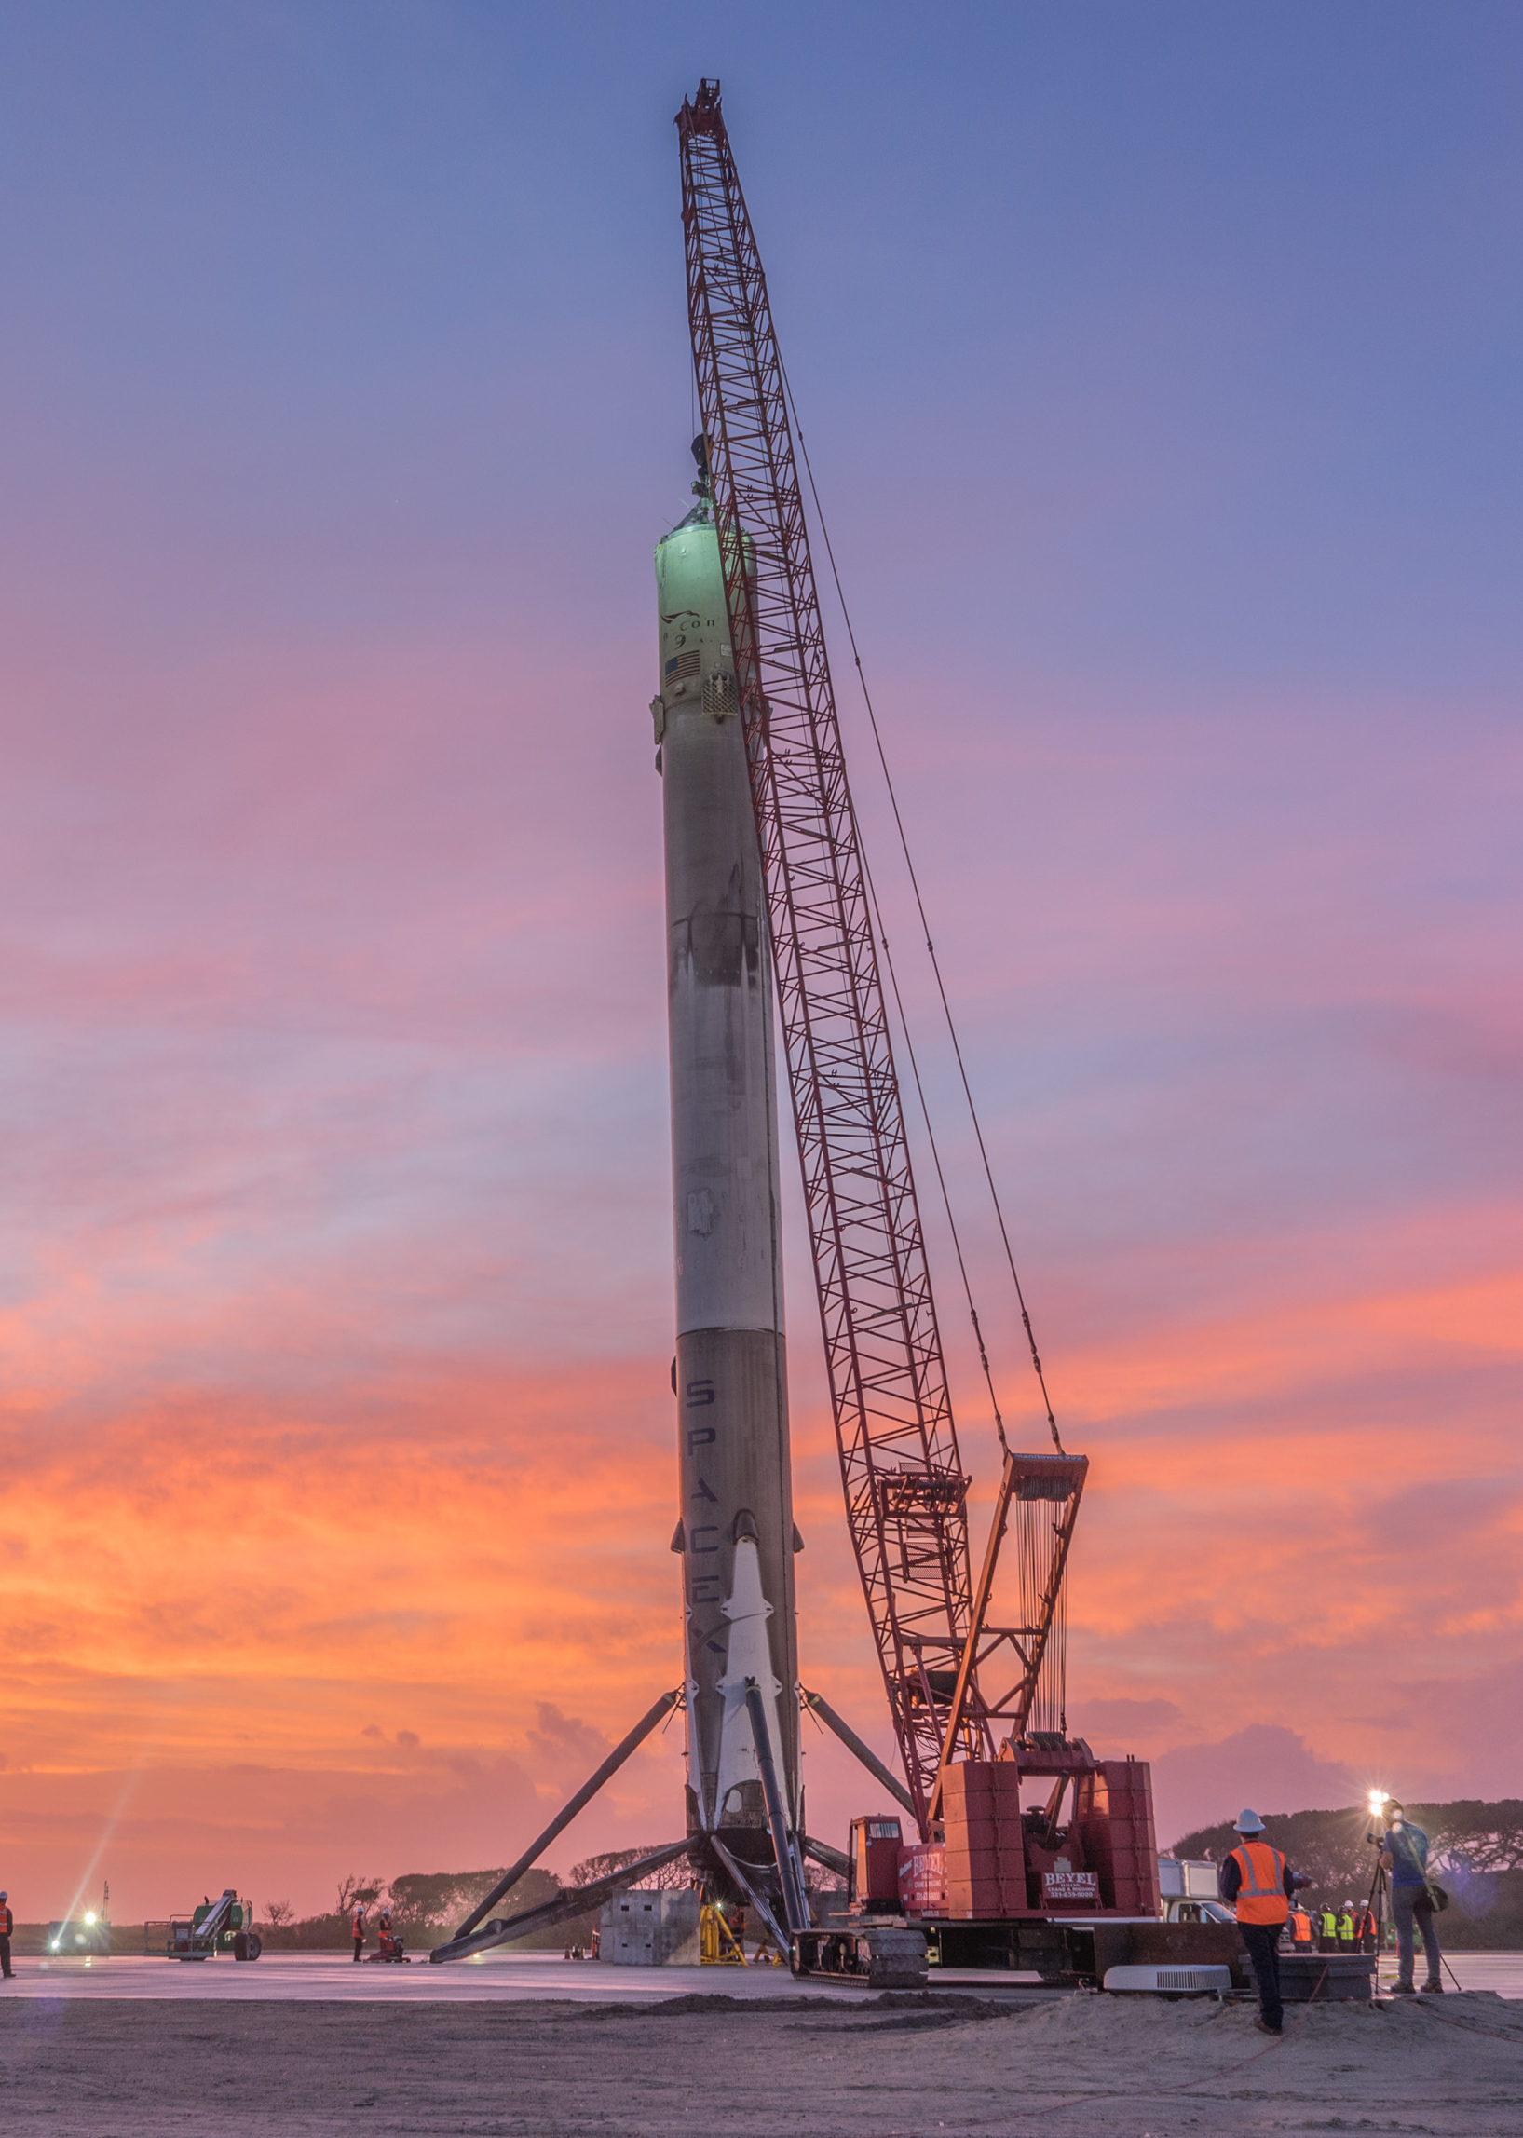
CONCLUSION
Predictive modeling is a viable approach to estimate Falcon 9 first-stage landing outcomes.
Among the tested classifiers, Logistic Regression, SVM, and KNN showed consistent and reliable performance.
Features like Payload Mass, Launch Site and Booster Version appear influential in determining landing success.
Certain operational conditions, such as launching from KSC LC-39A and medium payload ranges, are strongly linked to higher landing success.
This analysis provides actionable insights to support mission planning and landing reliability in future launches.

Slide 27
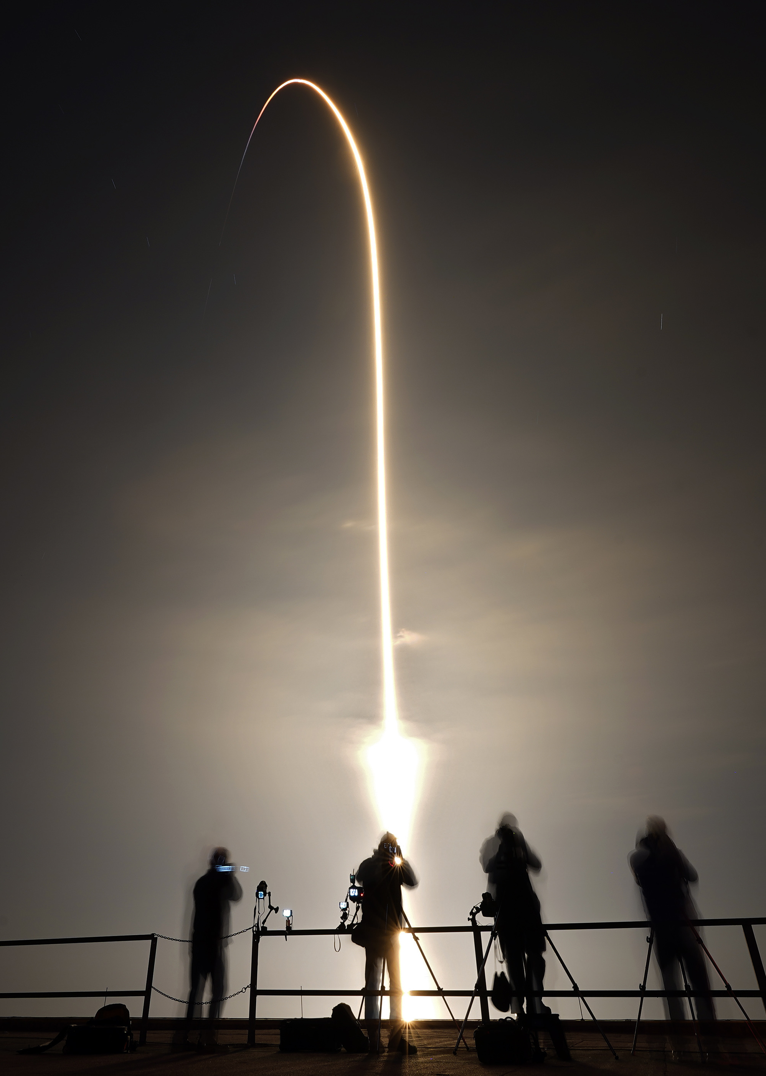
FUTURE DIRECTIONS
Explore ensemble learning techniques (e.g., Random Forest, Gradient Boosting) for improved performance and robustness.
Incorporate additional features (e.g., weather conditions, wind speed or launch trajectory) for greater model accuracy.
Develop a probabilistic or regression-based model to estimate the likelihood of landing success rather than just a binary output.
Deploy an interactive dashboard to dynamically simulate different scenarios with updated data.

